Slide 1
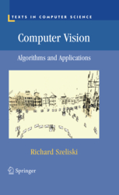
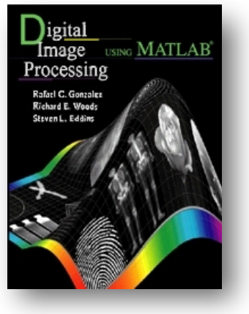
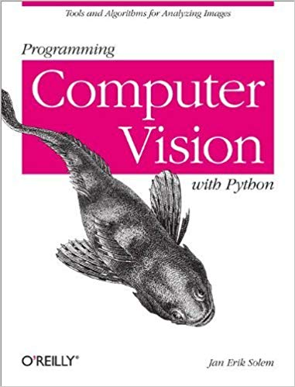
Fundamentals of Computer Vision
Last updated: 07-03-2024
[GR] Gonzalez, R. C., Woods, R.E. and Eddins, S.L., 2009. Digital Image Processing Using MATLAB, Fifth Impression. (Ch. 1)
[SR] Szeliski R., Computer Vision - Algorithms and Applications, Springer, 2011. (Ch. 2, 3)
[SJ] Solem, J. E., 2012. Programming Computer Vision with Python: Tools and algorithms for analyzing images. "O'Reilly Media, Inc.".
Slides adopted from: Dr. Zulfiqar Habib, Professor
Notes:
Information from www.csie.ntnu.edu.tw/~violet/IP93/Chapter02.ppt can also be added
Future
Python: https://www.anaconda.com/

Slide 2
Morphology
Morphological image processing (or morphology) describes a range of image processing techniques that deal with the shape (or morphology) of features in an image
Morphological operations are typically applied as a pre-processing step to remove imperfections/noise in many computer vision applications.

Slide 3
Morphology
Morphological image processing (or morphology) operations presented here are mostly applicable to binary images.
The input to most morphological operations are:
The input binary image
A small binary kernel named structuring element

Slide 4
Structuring Elements, Hits & Fits
All morphological processing operations are based on these simple ideas
B
Structuring Element
Fit: All on pixels in the structuring element cover on pixels in the image
Hit: Any on pixel in the structuring element covers an on pixel in the image
Miss: No on pixel in the structuring element covers an on pixel in the image
A
C

Slide 5
Fitting & Hitting
0 | 0 | 0 | 0 | 0 | 0 | 0 | 0 | 0 | 0 | 0 | 0
0 | 0 | 0 | 1 | 1 | 0 | 0 | 0 | 0 | 0 | 0 | 0
0 | 0 | 1 | 1 | 1 | 1 | 1 | 0 | 0 | 0 | 0 | 0
0 | 1 | 1 | 1 | 1 | 1 | 1 | 1 | 0 | 0 | 0 | 0
0 | 1 | 1 | 1 | 1 | 1 | 1 | 1 | 0 | 0 | 0 | 0
0 | 0 | 1 | 1 | 1 | 1 | 1 | 1 | 0 | 0 | 0 | 0
0 | 0 | 1 | 1 | 1 | 1 | 1 | 1 | 1 | 0 | 0 | 0
0 | 0 | 1 | 1 | 1 | 1 | 1 | 1 | 1 | 1 | 1 | 0
0 | 0 | 0 | 0 | 0 | 1 | 1 | 1 | 1 | 1 | 1 | 0
0 | 0 | 0 | 0 | 0 | 0 | 0 | 0 | 0 | 0 | 0 | 0
1 | 1 | 1
1 | 1 | 1
1 | 1 | 1
B
C
Structuring Element 1
0 | 1 | 0
1 | 1 | 1
0 | 1 | 0
A
Structuring Element 2

Slide 6
Structuring Elements
Structuring elements can be any size and make any shape
However, for simplicity we will use rectangular structuring elements with their origin at the middle pixel
0 | 0 | 1 | 0 | 0
0 | 1 | 1 | 1 | 0
1 | 1 | 1 | 1 | 1
0 | 1 | 1 | 1 | 0
0 | 0 | 1 | 0 | 0
1 | 1 | 1
1 | 1 | 1
1 | 1 | 1
0 | 1 | 0
1 | 1 | 1
0 | 1 | 0

Slide 7
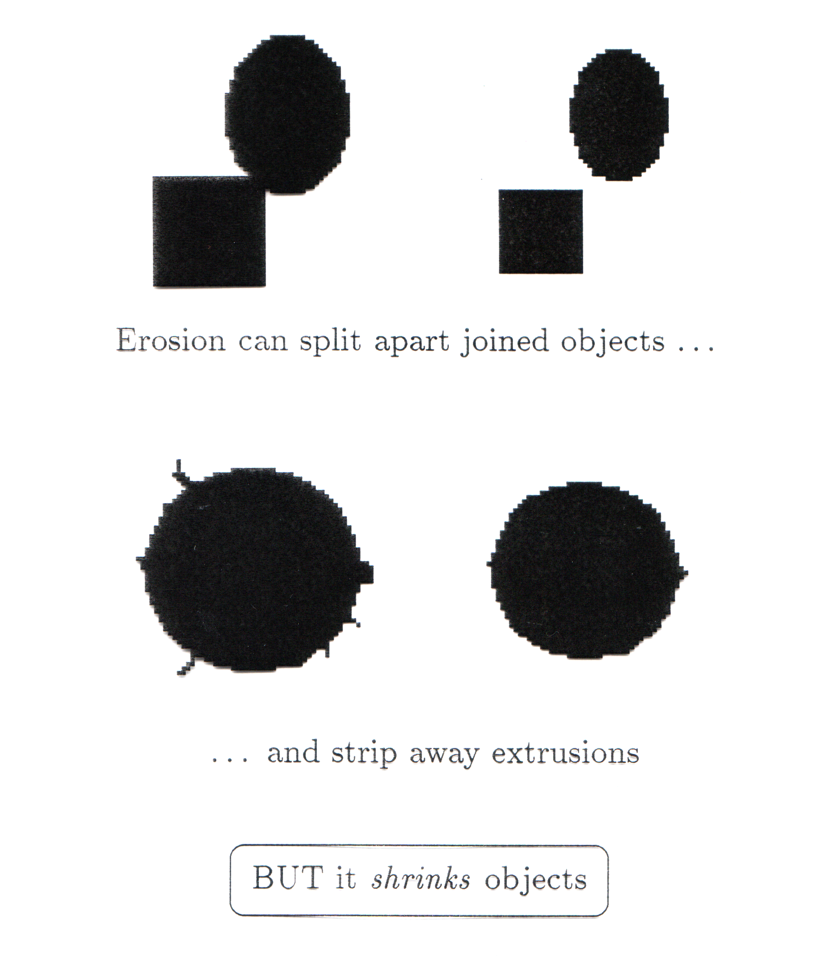
Erosion
Erosion of image f by structuring element s is given by f  s
The structuring element s is positioned with its origin at (x, y) and the new pixel value is determined using the rule:
Erosion shrinks objects

Slide 8
Erosion Example
Original Image
Processed Image With Eroded Pixels
Structuring Element

Slide 9
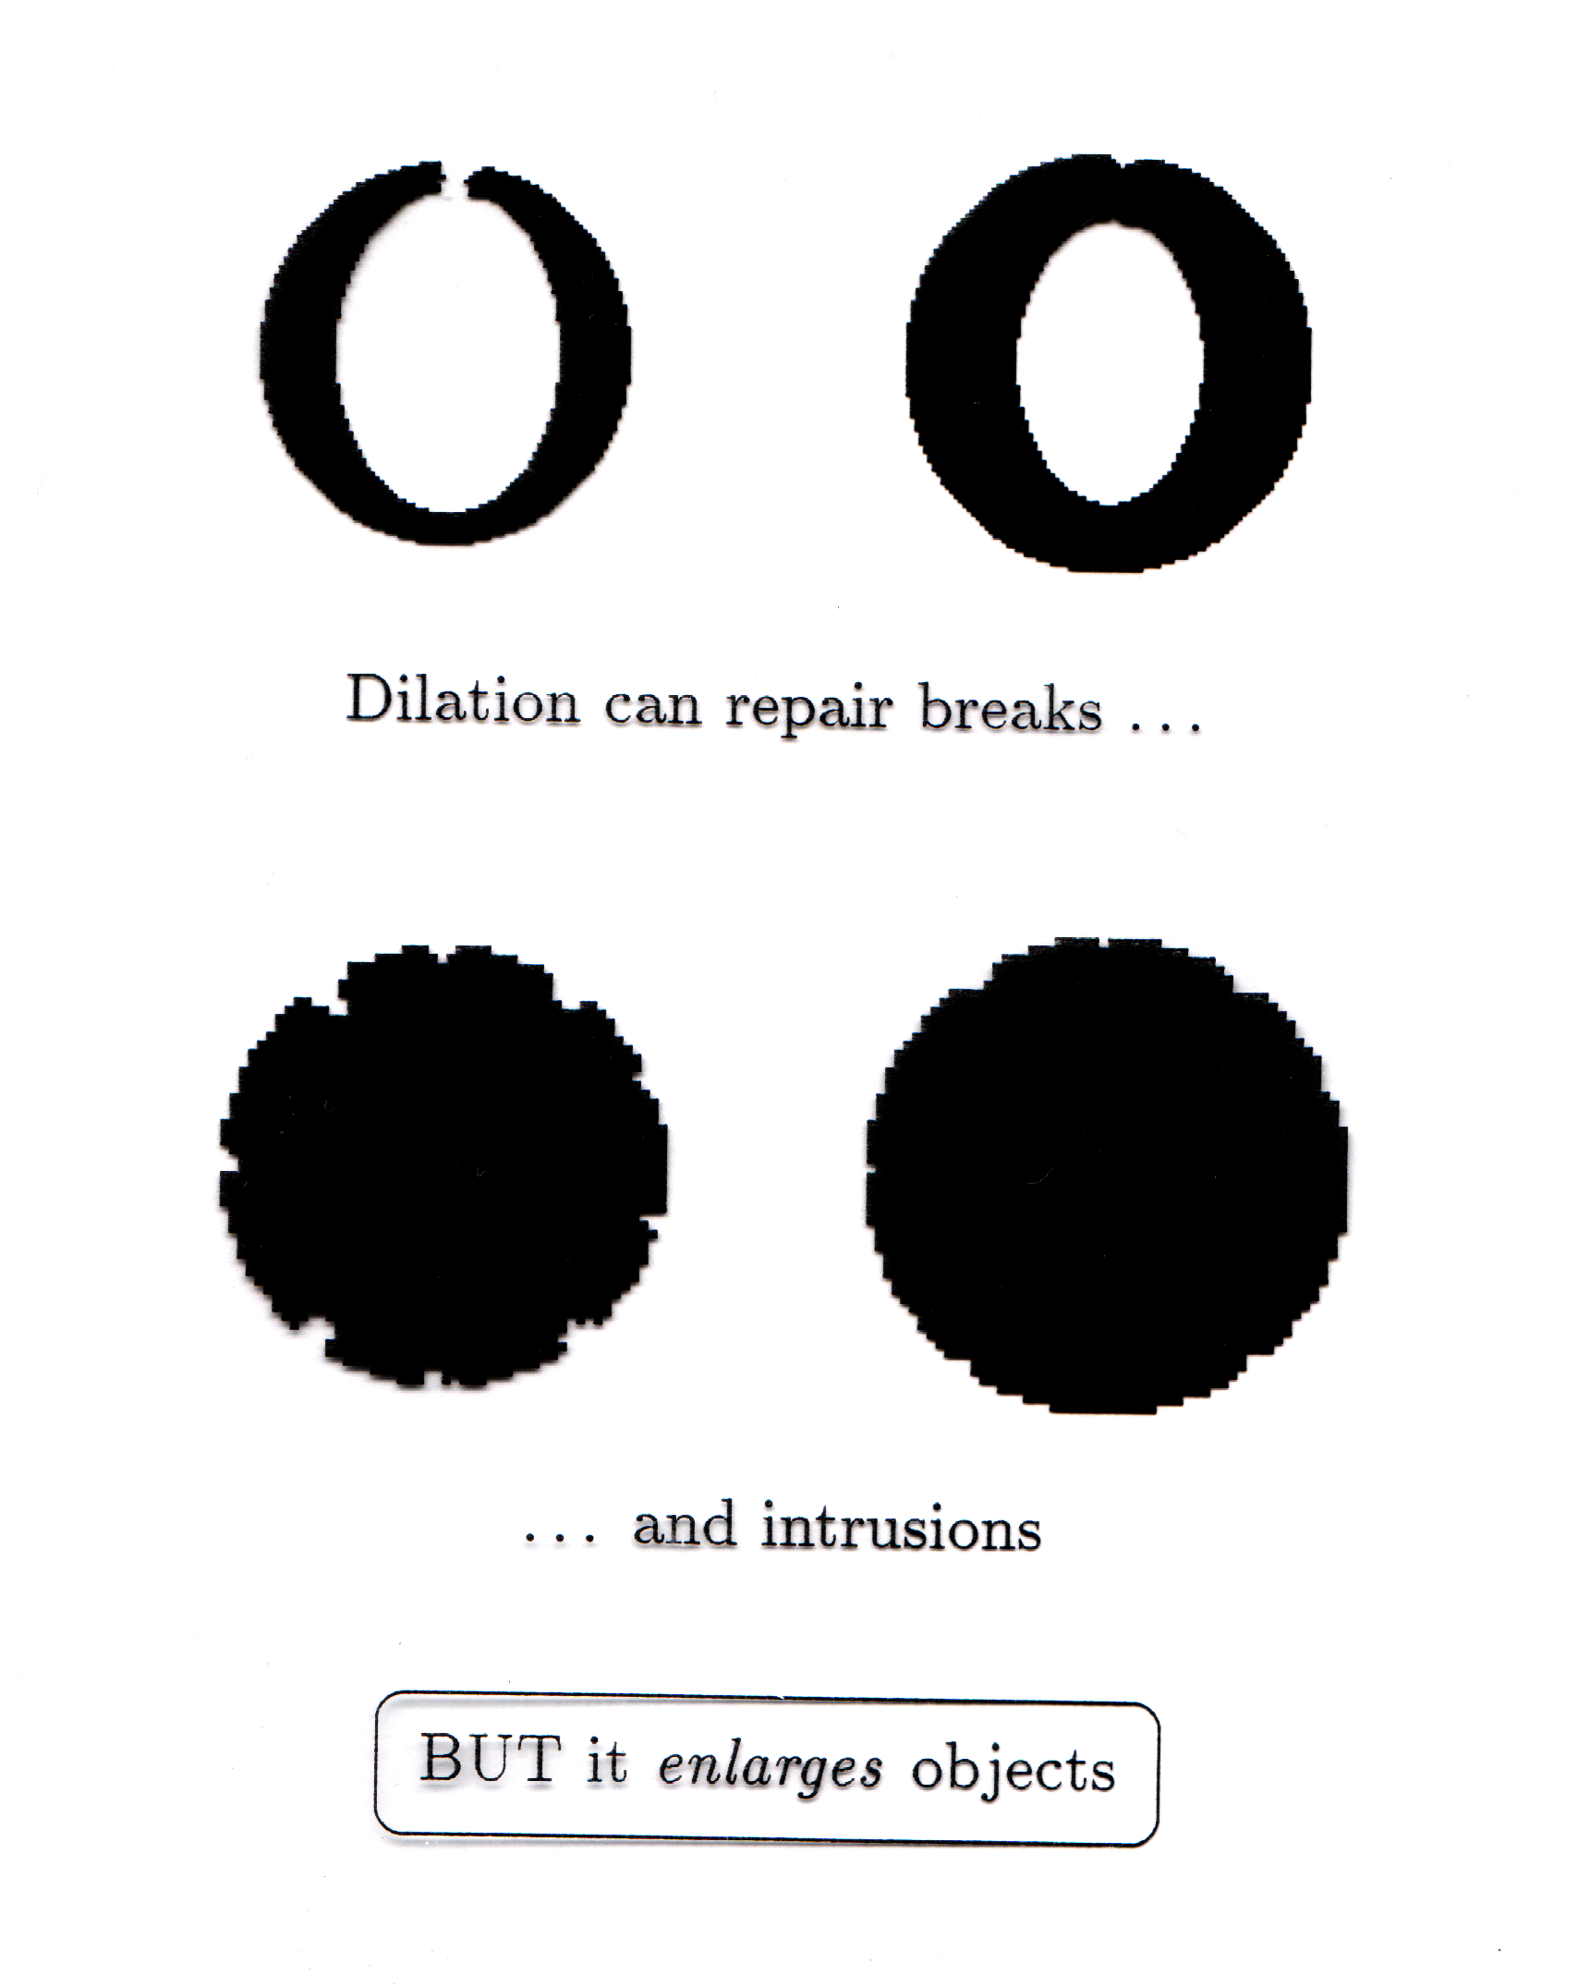
Dilation
Dilation of image f by structuring element s is given by f ⊕ s
The structuring element s is positioned with its origin at (x, y) and the new pixel value is determined using the rule:
Dilation enlarges objects

Slide 10
Dilation Example
Original Image
Processed Image
Structuring Element

Slide 11
Morphological Operations
More interesting morphological operations can be performed by performing combinations of erosions and dilations
The most widely used of these compound operations are:
Opening: f ○ s = (f  s) ⊕ s
Closing: f • s = (f ⊕ s)  s

Slide 12
Segmentation of Water in Bottles
import cv2
import numpy as np
from matplotlib import pyplot as plt
from skimage.filters import threshold_multiotsu
# Load the image
b = cv2.imread('bottles.tif', cv2.IMREAD_GRAYSCALE)
# Normalize and threshold the image using multi-level Otsu's method
thresholds = threshold_multiotsu(b, classes=3)
# Normalize thresholds to be in the range [0, 1]
normalized_thresholds = thresholds / 256.0
bL = b > thresholds[0]
bH = b > thresholds[1]
L = bL.astype(np.uint8) - bH.astype(np.uint8) # Subtract the high thresholded image from low
# Structuring elements for morphological operations
se5 = cv2.getStructuringElement(cv2.MORPH_ELLIPSE, (5, 5))
se10 = cv2.getStructuringElement(cv2.MORPH_ELLIPSE, (10, 10))
# Perform morphological operations
L1 = cv2.morphologyEx(L.astype(np.uint8), cv2.MORPH_OPEN, se5)
L2 = cv2.morphologyEx(L1, cv2.MORPH_CLOSE, se10)

Slide 13
Segmentation of Water in Bottles
# Plotting the results
plt.figure(figsize=(12, 8))
plt.subplot(2, 3, 1), plt.imshow(b, cmap='gray'), plt.title('Bottles')
plt.subplot(2, 3, 2), plt.imshow(bL, cmap='gray'), plt.title('Liquid White')
plt.subplot(2, 3, 3), plt.imshow(bH, cmap='gray'), plt.title('Liquid Black')
plt.subplot(2, 3, 4), plt.imshow(L, cmap='gray'), plt.title('Liquid with noise')
plt.subplot(2, 3, 5), plt.imshow(L1, cmap='gray'), plt.title('Liquid with less noise')
plt.subplot(2, 3, 6), plt.imshow(L2, cmap='gray'), plt.title('Pure Liquid')
plt.show()

Slide 14
Connected Components
The term connected component is defined in terms of a path, and the definition of a path in turn depends on adjacency.
To develop computer programs that locate & operate on objects, we need a set of definition for key terms.
N₄(p): the set of 4-neighbors of p
N₈(p): the set of 8-neighbors of p
p
p
Notes:
http://sites.google.com/site/ipum2009/chapter9-code

Slide 15
Connected Components
Two pixels p & q are said to be:
4-Adjacent if q∈N₄(p)
8-Adjacent if q∈N₈(p)
0 | 0 | 0 | 0 | 0
0 | 0 | 1 | 1 | 1
0 | 0 | 1 | 0 | 0
1 | 1 | 1 | 0 | 0
0 | 0 | 0 | 0 | 0
p
0 | 0 | 0 | 0 | 0
0 | 0 | 0 | 1 | 1
0 | 0 | 1 | 0 | 0
1 | 1 | 0 | 0 | 0
0 | 0 | 0 | 0 | 0
p

Slide 16
Connected Components
A path between pixels p₁ and p_{n} is a sequence of pixels p₁, p₂,…,p_{n-1}, p_{n} s.t., p_{k} is adjacent to p_{k+1}, for 1≤k<n. A path can be:
4-connected or 8-connected.
Two pixels p & q are said to be 4- (or 8-) connected, if there exist a 4- (or 8-) path between them, consisting entirely of foreground pixels.
0 | 0 | 0 | 0 | 0
0 | 0 | 1 | 1 | 1
0 | 0 | 1 | 0 | 0
1 | 1 | 1 | 0 | 0
0 | 0 | 0 | 0 | 0
p
0 | 0 | 0 | 0 | 0
0 | 0 | 1 | 1 | 1
0 | 0 | 1 | 0 | 0
1 | 1 | 0 | 0 | 0
0 | 0 | 0 | 0 | 0
p

Slide 17
Labeling Connected Components
1 | 1 | 1 | 0 | 0 | 0 | 0 | 0
1 | 1 | 1 | 0 | 1 | 1 | 0 | 0
1 | 1 | 1 | 0 | 1 | 1 | 0 | 0
1 | 1 | 1 | 0 | 0 | 0 | 1 | 0
1 | 1 | 1 | 0 | 0 | 0 | 1 | 0
1 | 1 | 1 | 0 | 0 | 0 | 1 | 0
1 | 1 | 1 | 0 | 0 | 1 | 0 | 0
1 | 1 | 1 | 0 | 0 | 0 | 0 | 0
1 | 1 | 1 | 0 | 0 | 0 | 0 | 0
1 | 1 | 1 | 0 | 2 | 2 | 0 | 0
1 | 1 | 1 | 0 | 2 | 2 | 0 | 0
1 | 1 | 1 | 0 | 0 | 0 | 4 | 0
1 | 1 | 1 | 0 | 0 | 0 | 4 | 0
1 | 1 | 1 | 0 | 0 | 0 | 4 | 0
1 | 1 | 1 | 0 | 0 | 3 | 0 | 0
1 | 1 | 1 | 0 | 0 | 0 | 0 | 0
p
Four 4-Connected Components Label Matrix

Slide 18
import numpy as np
from scipy.ndimage import label
# Define the binary image f (assuming 1's represent foreground and 0's represent background)
f = np.array([
[1, 1, 1, 0, 0, 0, 0, 0],
[1, 1, 1, 0, 1, 1, 0, 0],
[1, 1, 1, 0, 1, 1, 0, 0],
[1, 1, 1, 0, 0, 0, 1, 0],
[1, 1, 1, 0, 0, 0, 1, 0],
[1, 1, 1, 0, 0, 0, 1, 0],
[1, 1, 1, 0, 0, 1, 0, 0],
[1, 1, 1, 0, 0, 0, 0, 0]
], dtype=int)
# Use scipy.ndimage.label to label the connected components
L, n = label(f, structure=np.array([[0,1,0],[1,1,1],[0,1,0]]))
# L is the label matrix and n is the number of labels
# Note: Using a structure that defines 4-connectivity
print("Label Matrix (L):\n", L)
print("Number of Labels (n):", n)

Slide 19
Labeling Connected Components
1 | 1 | 1 | 0 | 0 | 0 | 0 | 0
1 | 1 | 1 | 0 | 1 | 1 | 0 | 0
1 | 1 | 1 | 0 | 1 | 1 | 0 | 0
1 | 1 | 1 | 0 | 0 | 0 | 1 | 0
1 | 1 | 1 | 0 | 0 | 0 | 1 | 0
1 | 1 | 1 | 0 | 0 | 0 | 1 | 0
1 | 1 | 1 | 0 | 0 | 1 | 0 | 0
1 | 1 | 1 | 0 | 0 | 0 | 0 | 0
1 | 1 | 1 | 0 | 0 | 0 | 0 | 0
1 | 1 | 1 | 0 | 2 | 2 | 0 | 0
1 | 1 | 1 | 0 | 2 | 2 | 0 | 0
1 | 1 | 1 | 0 | 0 | 0 | 2 | 0
1 | 1 | 1 | 0 | 0 | 0 | 2 | 0
1 | 1 | 1 | 0 | 0 | 0 | 2 | 0
1 | 1 | 1 | 0 | 0 | 2 | 0 | 0
1 | 1 | 1 | 0 | 0 | 0 | 0 | 0
p
Four 8-Connected Components Label Matrix

Slide 20
import numpy as np
from scipy.ndimage import label
# Define the binary image f (assuming 1's represent foreground and 0's represent background)
f = np.array([
[1, 1, 1, 0, 0, 0, 0, 0],
[1, 1, 1, 0, 1, 1, 0, 0],
[1, 1, 1, 0, 1, 1, 0, 0],
[1, 1, 1, 0, 0, 0, 1, 0],
[1, 1, 1, 0, 0, 0, 1, 0],
[1, 1, 1, 0, 0, 0, 1, 0],
[1, 1, 1, 0, 0, 1, 0, 0],
[1, 1, 1, 0, 0, 0, 0, 0]
], dtype=int)
# Use scipy.ndimage.label to label the connected components
L, n = label(f, structure=np.array([[1,1,1],[1,1,1],[1,1,1]]))
# L is the label matrix and n is the number of labels
# Note: Using a structure that defines 4-connectivity
print("Label Matrix (L):\n", L)
print("Number of Labels (n):", n)

Slide 21
Labeling Connected Components
# Find row and column indices where L == 2
r, c = np.where(L == 2)
print("Rows where L == 2:", r)
print("Columns where L == 2:", c)
# Find centroid for component with L = 2
centroid = np.round([np.mean(r), np.mean(c)]).astype(int)
print("Centroid (rounded to nearest integer):", centroid)
1 | 1 | 1 | 0 | 0 | 0 | 0 | 0
1 | 1 | 1 | 0 | 2 | 2 | 0 | 0
1 | 1 | 1 | 0 | 2 | 2 | 0 | 0
1 | 1 | 1 | 0 | 0 | 0 | 2 | 0
1 | 1 | 1 | 0 | 0 | 0 | 2 | 0
1 | 1 | 1 | 0 | 0 | 0 | 2 | 0
1 | 1 | 1 | 0 | 0 | 2 | 0 | 0
1 | 1 | 1 | 0 | 0 | 0 | 0 | 0
Rows where L == 2: [1 1 2 2 3 4 5 6]
Columns where L == 2: [4 5 4 5 6 6 6 5]
Centroid: [3 5]

Slide 22
Labelling All Objects
import numpy as np
import matplotlib.pyplot as plt
from skimage import io
from skimage.measure import label, regionprops
from skimage.color import label2rgb
# Load the image
f = io.imread('objects.tif')
# Label the image
L, n = label(f > 0, return_num=True) # Assuming the image is binary; adjust the threshold as necessary
# Display the image
plt.imshow(f, cmap='gray')
# Iterate over each labeled region to find and plot the centroid
for region in regionprops(L):
rbar, cbar = region.centroid
plt.plot(cbar, rbar, 'r*') # Plot the centroid with a red asterisk
plt.show()
objects.tif
Notes:
bwlabel(f) is 8-connected by defaults unless we write bwlabel(f, 4)

